Slide 1
2048 Game
Presented and Developed by Husna Noor
Submitted to and Supervised by: Engr. Madiha Sheer

Slide 2
Agenda
What and Why 2048
Mechanisms of 2048
How did we make it
All the functions and techniques used

Slide 3
What and Why 2048
2048 is an addicting game made by many developers in order to kill time and have fun while they add numbers and add up to 2048

Slide 4
Mechanism of 2048
The Rules of the 2048 game is very simple.
Move the numbers and combine two similar numbers to add them to get 2048.
The numbers are in multiples of 2.

Slide 5
How did we make it
We used 5 functions.
A Function for a New game
A function for the UI
A function for generating Numbers
A function for Applying Move
The board was made through the help of Arrays.
Most of the functions were reliant on Arrays.

Slide 6
How did we make it part 2
We used unique Logics to create the movement of the numbers
We used more logic to create the random generations of number.
We also used 4 libraries Namely
Iostream
Cstdlib
Ctime
iomanip

Slide 7
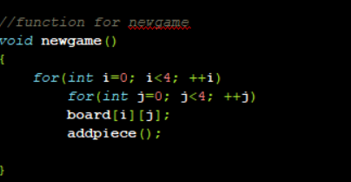
All the functions used 1
New game function.
We used a for loop to create a board
With empty positions.
And in the functions we called the
Add piece function to add numbers to
The board.

Slide 8
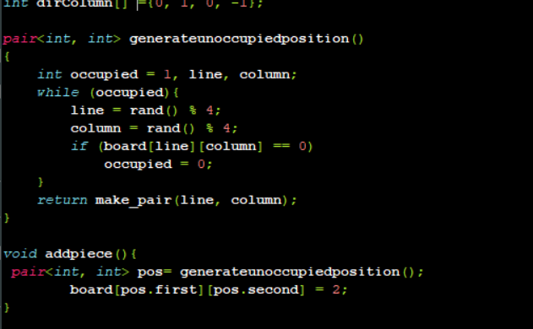
All the functions used 2
This function is the Add piece function.
Which purpose is to create a random number every time the position isn’t occupied or occupied.
To generate random number cstdlib library was used. And the random number’s modulus is found with 4 to output the number “2” every time.

Slide 9
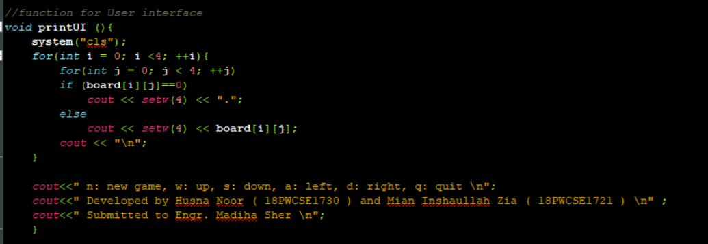
All the functions used 3
This Function used for printing the UI.
System clear is used for a cleaner UI.

Slide 10
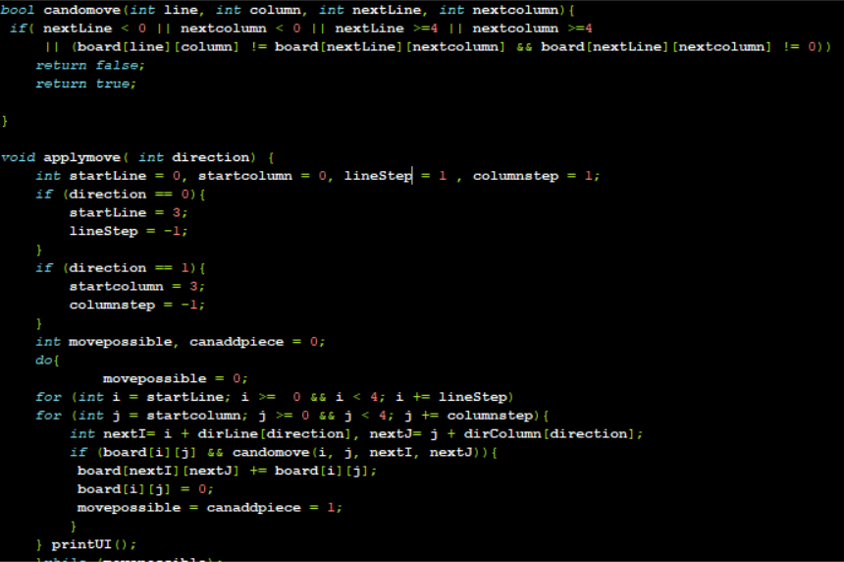
All the functions used 4
Here is the most logical part of the code.
This code is implemented to process on the direction given by the user in the matrix.
Although it looks very complex it isn’t that hard to understand.
We used candomove function to make sure if the move set by user is possible or not.
While we use the applymove function to apply the move set by the user.

Slide 11
Conclusion
We used simple functions and pre-defined functions set by libraries to create certain things and navigate the directions by the user and to create a flawless game.
Here’s the presentation of the game.

Slide 12
THE END
Thank you
Made by Husna

